Slide 1
CS305: Computer Architecture
Tutorial-II
https://www.cse.iitb.ac.in/~biswa/courses/CS305/main.html

Slide 2
Problem-1
Consider the following instruction runs on a 5-stage pipelined processor:
add $2, $3, $4
lw $1, 4($2)
sub $4, $1, $5
add $6, $1, $5
and $8, $1, $7
Find the # of cycles needed to execute these instructions a)without operand forwarding, b)with operand forwarding.

Slide 3
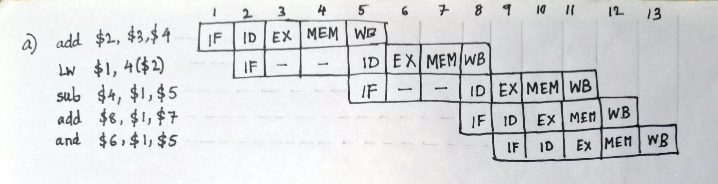
Solution

Slide 4
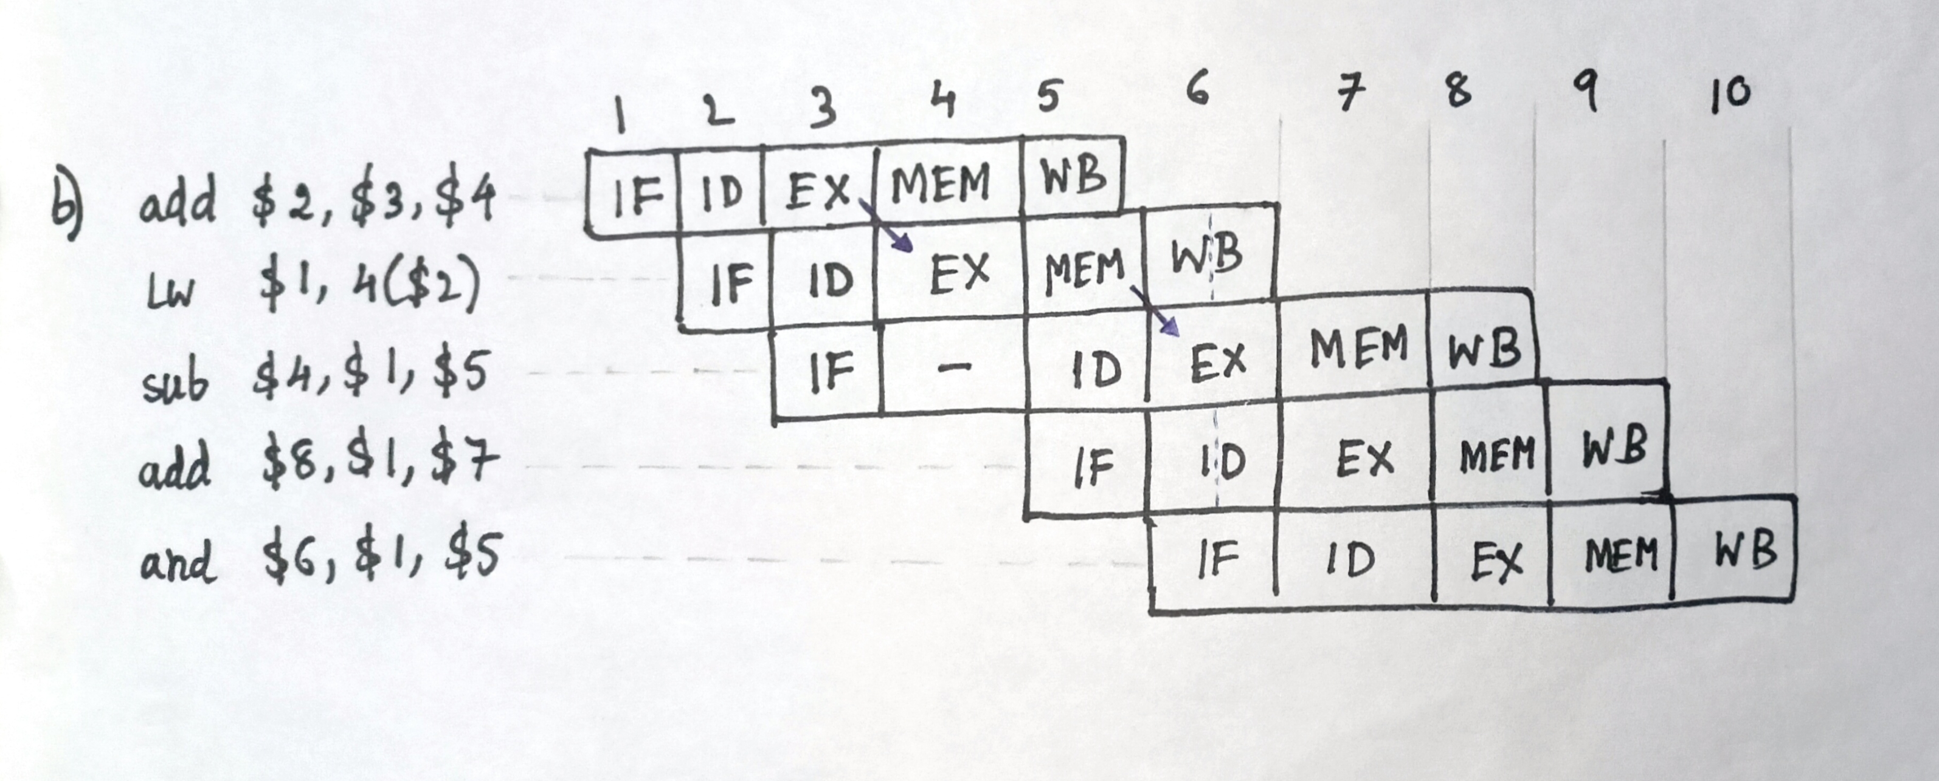
Solution

Slide 5
Problem-2
An instruction pipeline has five stages where each stage take 2 nanoseconds. All branches are resolved after the execute stage.
Calculate the average instruction execution time assuming that 20% of all instructions executed are branch instructions. Ignore the fact that some branch instructions may be conditional.
Assume 80% of all branch instructions are conditional branch instructions, and 50% of the conditional branch instructions are such that the branch is taken, calculate the average instruction execution time. Assume an always-not taken predictor is used.

Slide 6
Solution
a) # of stalls per branch = 2
avg. CPI = 1 + stall for branches
= 1 + 0.2*2
= 1.4
avg. instruction exec. Time = 1.4 * 2 ns
= 2.8 ns
b) avg. CPI = 1 + 0.2(0.2*2 + 0.8*0.5*2)
= 1.24
avg. instruction exec. Time = 1.24 * 2 ns
= 2.48 ns

Slide 7
Problem-3
Consider the repeating pattern (e.g., in a loop) of branch outcomes: T, NT, T, T, NT
What is the accuracy of always-taken and always-not-taken predictors for this sequence of branch outcomes?
What is the accuracy of the two-bit hysteresis predictor(the one in lecture slides) for the first 5 branches in this pattern, assuming that the predictor starts off in the strongly not-taken state?
What is the accuracy of the two-bit predictor if this pattern is repeated forever?

Slide 8
Solution
accuracy of always taken = 60 %
accuracy of always not-taken = 40 %
accuracy of 2-bit predictor on 1st 5 branch = 20 %
accuracy of 2-bit predictor(forever) = 60 %

